Slide 1


TELEGRAM BOT
Educatinal material

Slide 2
Introduction
Each of us has met with something that we didn’t understand a lecture or a lesson or a theme. We spend a lot of time looking for the material that we need. But what if we find a way not to waste time.

Slide 3

Idea and reason
IDEA: HELP STUDENTS
Reason: make it easier for someone

Slide 4
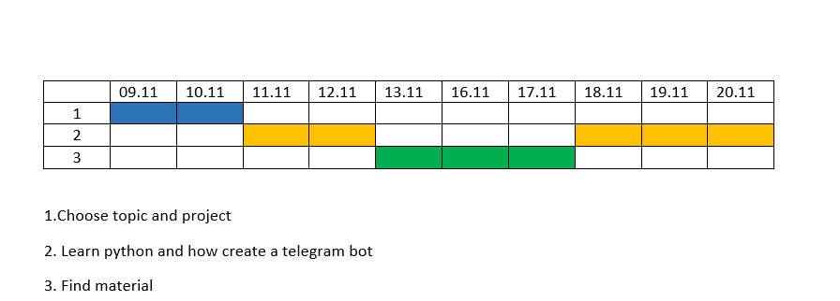
Gantt chart

Slide 5


Programs
PYTHON
PYCHARM

Slide 6
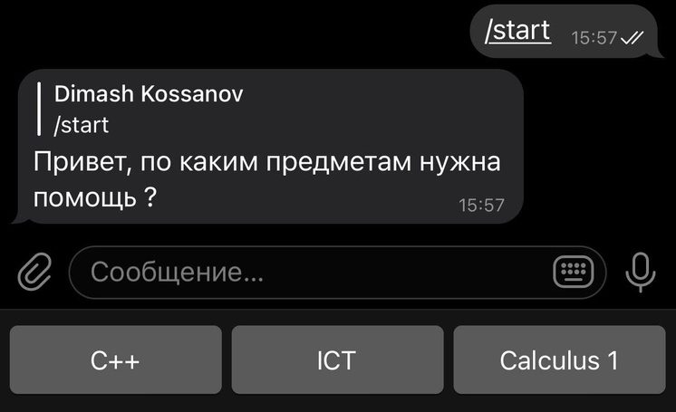
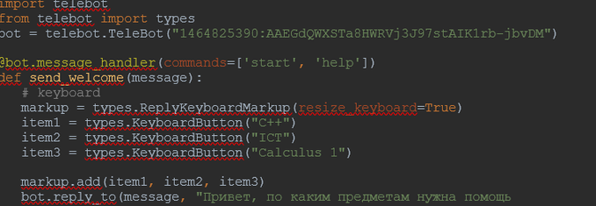
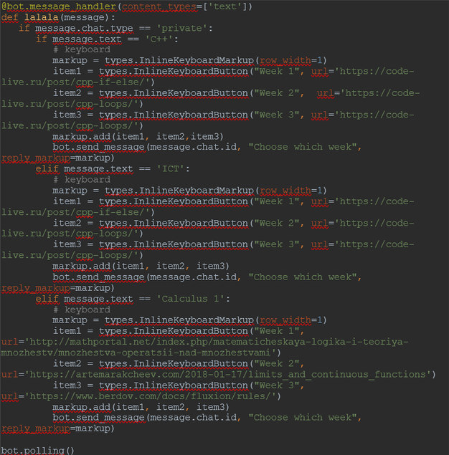
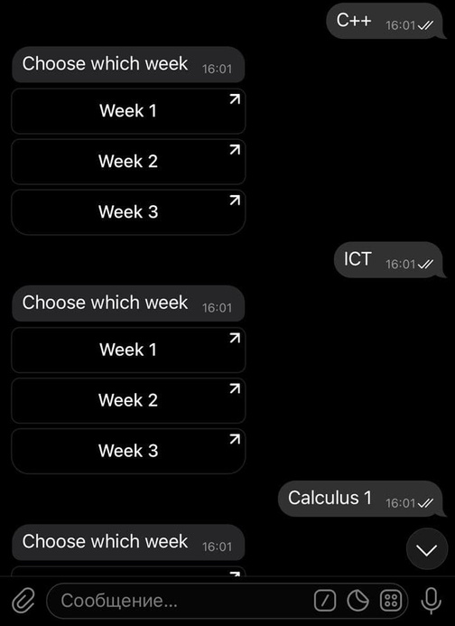
CODE

Slide 7

REFERNCES
https://habr.com/ru/post/442800/
https://github.com/irevenko/info-bot
https://www.canva.com/
Material
https://artemarakcheev.com/2018-01-17/limits_and_continuous_functions
http://mathportal.net/index.php/matematicheskaya-logika-i-teoriya-mnozhestv/mnozhestva-operatsii-nad-mnozhestvami'
'https://code-live.ru/post/cpp-loops/

Slide 8
Conclusion
SUCCESS
PROBLEMS
LEARNED
BOT
Useful and necessary idea
Easy to use
Find material
Unterstand mistake in code
Fulfill the plan
Create a telegram bot
Python language
Choose right information
Performs specified functions

Slide 9
Thank you for your attention
Teacher: Aidana Kalakova
Student: Kossanov Dinmukhamed
Group: SE-2002

